Slide 1
For Loops
use less code to get more done
Notes:
Welcome to Day 3 in our Beginning Python Challenge!
In this video we’re going to look at for loops, which allow us to use less code to get more done.

Slide 2
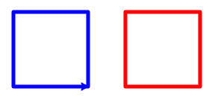
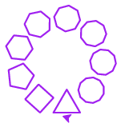
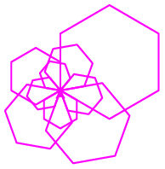
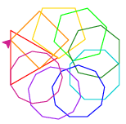
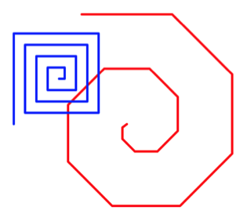
Challenge Overview
Day 1: Getting started
Day 2: Variables & Turtle
Day 3: Loops
Day 4: Writing Functions
Day 5: Putting it all together!
Hello, World!
Notes:
Let’s take a look at where we’ve come in the challenge so far.
Now let’s look a little more deeply into how we can automate repetitive tasks with for loops in python.

Slide 3
Why Loops? Less is more!
vs
print(1)
print(2)
print(3)
print(4)
print(5)
print(6)
print(7)
print(8)
print(9)
print(10)
for i in range(1, 11):
print(i)
2 lines better than 10, 100, or 1000 lines
Less code = less problems to test, fix, & change later
Don’t Repeat Yourself (DRY)
Loops automate repetitive tasks
Notes:
2 lines or 10, 100, 1000 lines? DRY (Don’t Repeat Yourself)
Imagine you wanted to print out the numbers from 1-100 instead of 1-10 – on the left you would be doing a ton of copy & pasting, on the right, you change 11 to 101 – simple, right?
This is a concept known as DRY – not repeating ourselves. Whenever we’re copying & pasting, it’s usually an indicator that there is a better way, and it’s up to us as programmers to learn that better way.
Let’s dive in deeper into how for loops in python work.

Slide 4
Example: Print 1-10
Loop Variable
Declaration
# long way
print(1)
print(2)
print(3)
print(4)
print(5)
print(6)
print(7)
print(8)
print(9)
print(10)
Keyword
Keyword
Sequence
for i in range(1, 11):
print(i)
Loop body is indented
Repeated code
Loop Variable Use
Notes:
Let’s dive in deeper into how for loops in python work.

Slide 5
For Loop Template
for <loop variable> in <sequence>:
# do repeated code
Loop Variable: variable that gets assigned the next value in sequence at every repetition of the loop
Sequence: can be
Repeated code: code that gets executed at every repetition of the loop, likely uses the loop variable
Characters in a string
Items in a list
Range of numbers
Lines in a file
Notes:
Let's abstract away a template from our example

Slide 6
Example: String For Loop
for <loop variable> in <sequence>:
# do repeated code
# output
h
e
l
l
o
At every repetition of the loop, the loop variable char is getting the next value in the sequence “hello”.
for char in “hello”:
print(char)
Executes once for each letter in the string “hello”

Slide 7
Example: Range For Loop
for <loop variable> in <sequence>:
# do repeated code
# output
0
1
2
3
At every repetition of the loop, the loop variable i is getting the next value in the sequence 0, 1, 2, 3.
for i in range(4):
print(i)
Begins at 0 and goes up through but not including 4

Slide 8
Range Explained
including
excluding
# sequence
range(x) [0, x)
range(10) 0, 1, 2, …, 8, 9
range(x, y) [x, y)
range(5, 9) 5, 6, 7, 8
range(x, y, z) [x, y) incrementing by z
range(4, 12, 2) 4, 6, 8, 10
start
stop
step
Notes:
Now let’s dive deeper into the range function. There are actually 3 different ways to call the range function in python

Slide 9
What will this code output?
for j in range(1, 13, 3):
print(j)
# output
1
4
7
10
Up through but not including
for k in range(5, -20, -5):
print(k)
# output
5
0
-5
-10
-15
Counting down!
Notes:
Let’s practice! Pause & try on your own!
If you are able to correctly predict the code’s output, it demonstrates that you’ve mastered this form of loop

Slide 10
What will this code output?
for letter in range(10):
print(“hello”)
# output
hello
hello
hello
hello
hello
hello
hello
hello
hello
hello
Not using the loop variable!
for i in range(2, -10, 4):
print(i)
# output
Impossible range!
No output!
Notes:
Are you ready for some challenge problems? Pause & try on your own!
Can’t get from 2 to -10 going up by 4!

Slide 11
Let’s try it!
Go to trinket.io/turtle & load the code from Day 2 on left
We’re going to further practice predicting what for loops will output as well as make our code DRYer using a loop
See worksheet for details & video solutions: bit.ly/beginning-python-challenge-day3
See you in Day 4: Functions!
Notes:
For more details & video walk thru solutions, check out the link to the worksheet.
Can’t wait to see you for Day 4, where we learn how to harness the power of programming by writing our own functions!

Slide 12
Notes:
Great job learning about loops today! Check out the activity WS & post your progress once you’ve completed the exercise! I can’t wait to see what you create!
--------
python, joy of coding, programming, beginners, for loops, range

